Slide 1
PROBLEM STATEMENT
Existing fraud detection systems mainly focus on SMS or email and do not analyze live phone call conversations, which are a major source of scams in India, especially with the rise of digital payments through Unified Payments Interface. They lack the ability to understand spoken language, context, and social engineering tactics such as urgency, fear, or impersonation used by fraudsters. As a result, users do not receive real-time warnings during calls and often realize the fraud only after financial loss. Our model addresses this gap by analyzing recorded phone calls, converting speech to text, and using natural language processing to detect fraudulent intent and classify calls as safe or fraud in real time.

Slide 2
SOLUTION APPROACH
Our model improves existing systems by introducing voice-based fraud detection that analyzes phone call conversations in real time. It uses the Whisper model to accurately convert speech into text, even in noisy or natural conversational settings. The transcribed text is then processed using Whisper Model to understand the context, intent, and social engineering patterns such as urgency, fear, and impersonation. Unlike traditional systems that only focus on SMS or emails, our model detects fraud directly from calls and classifies them as fraud or safe, providing timely alerts and helping prevent financial scams, especially those related to Unified Payments Interface.

Slide 3
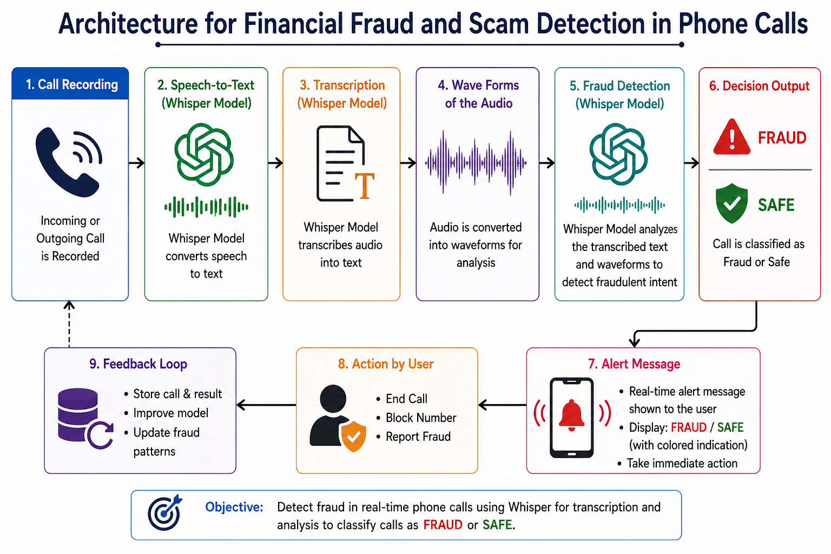
ARCHITECTURE

Slide 4
TECH STACK
1.Technologies
Python
HTML
2. Frameworks / Models
Whisper
Transformers
Streamlet
Flask
Jsonify
Imageio_ffmpeg
3.Tools
Spyder (IDE)
Summary
Python-based system using Whisper for speech-to-text with HTML frontend and Python backend.

Slide 5
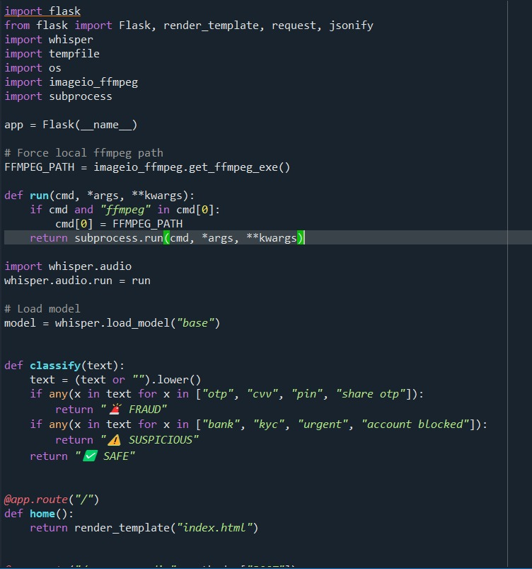
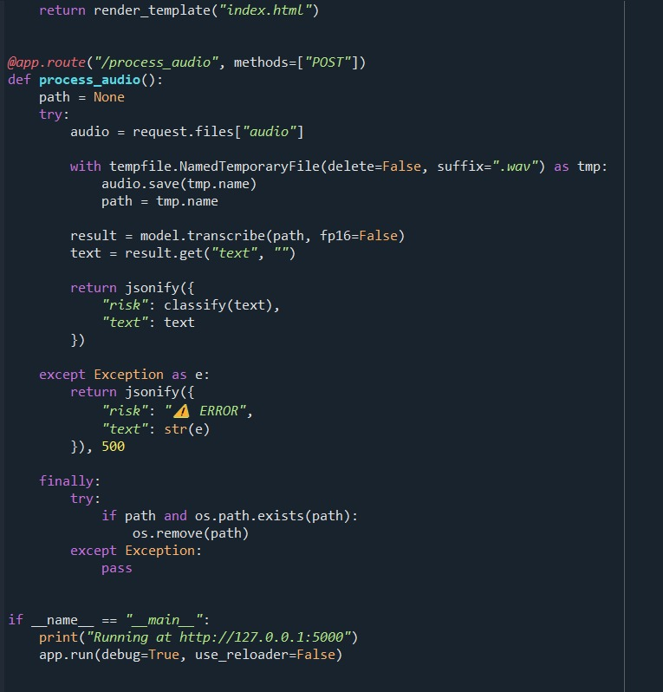
DEMO SCREENSHOTS

Slide 6



Slide 7
FUTURE SCOPE
The future of multilingual UPI scam detection lies in AI-driven, real-time, and user-aware systems that combine speech processing, behavioral analytics, and collaborative intelligence. As fraudsters adopt advanced technologies like deepfakes and AI-generated scams, detection systems must evolve into adaptive, multilingual, and proactive security frameworks to ensure safe digital transactions in India.

